Slide 1
Web Search Engine
COMP8547 – Advanced Computing Concepts Final Project
Instructor: | Dr. Mahdi Firoozjaei
Team Members: | Yuchen Shen (110073008)
 | Jitong Yang (110030800)
 | Yicheng Lu (105035846)

Slide 2
Outline
Introduction | 01
Structure | 02
Concepts & Practice | 03
04 | Demo
05 | Conclusion

Slide 3
01
Introduction

Slide 4
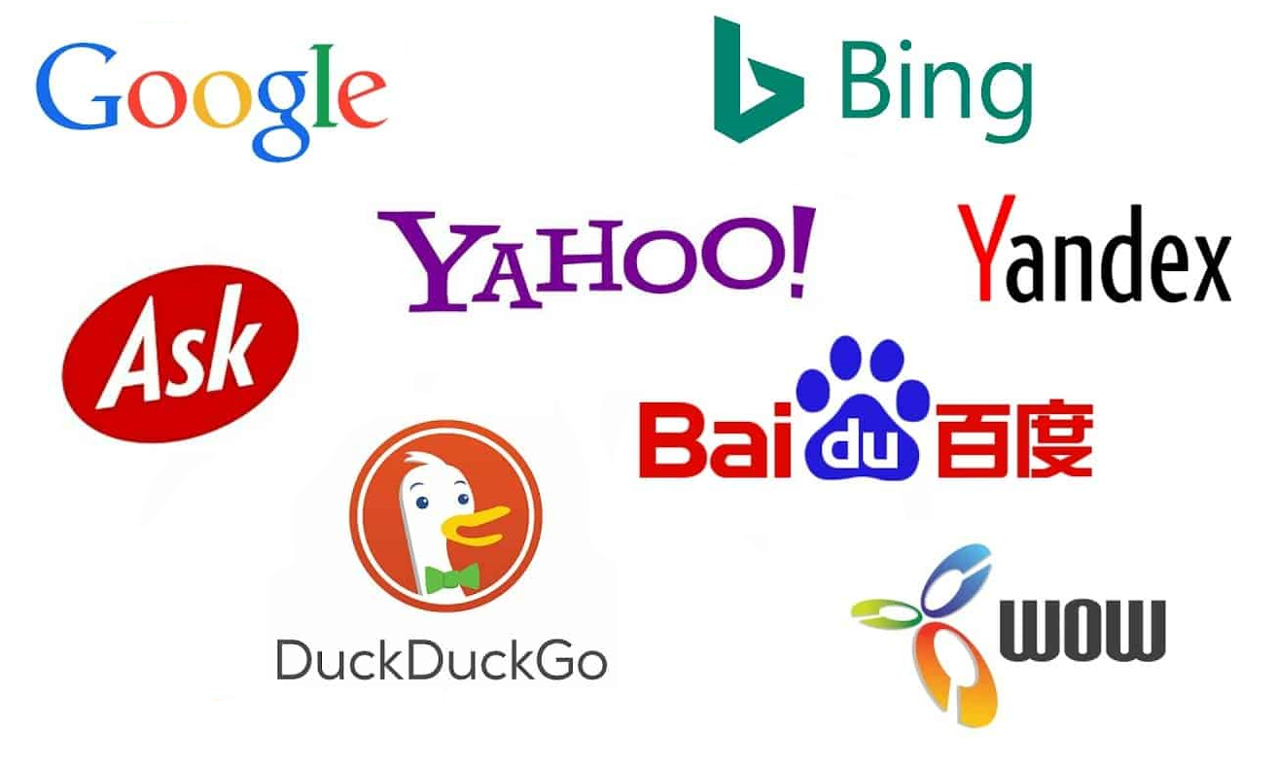
What is web search engine?
A retrieval technology
Retrieve information from the Internet
Feed information back to users
Figure1: Various Web Search Engine. From: ARTICLES ABOUT IT & REMOTE DESKTOP SOFTWARE, by Warren R., 2020, Retrieved from https://aeroadmin.com/articles/en/2020/how-search-engines-work/

Slide 5

Core Modules
Crawler
Document knowledge base server
Index
Sorting
Link Analysis
Webpage de-duplication
Webpage anti-spam
Query analysis
Page description/summary
Figure2: Search Engine. From: Which Search Engine Should I Use?
, by Fisher, 2021, Retrieved from https://www.lifewire.com/which-search-engine-should-i-use-3482052

Slide 6
02
Structure

Slide 7
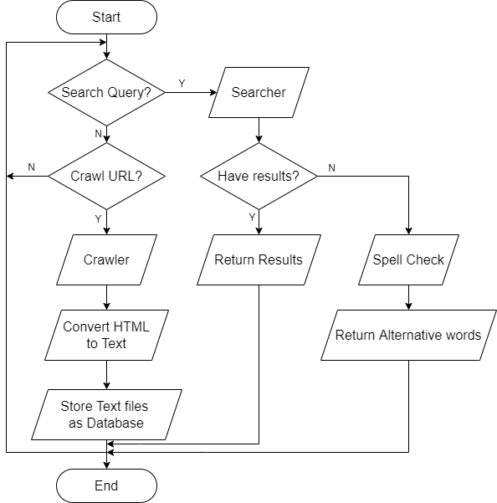
Flow Chart

Slide 8
03
Concepts & Practice
Notes:
At the third part of the presentation, let me show some main features which are implemented in our web search engine project.

Slide 9
Team Members‘ Responsibility
Jitong Yang – Crawler.java
Yuchen Shen - Searcher.java
Yicheng Lu - SpellChecking.java
Notes:
Those main features are assigned to each team members to implement. I am responsible for crawling web page and converting html files into text files.Yuchen is responsible for regex and inverted index. And Yicheng is responsible for tst and spell checking. At the next part, Yuchen will introduce the structure of our project.

Slide 10
Crawler Author: Jitong Yang
Jsoup
Parsing HTML from a URL, file or string
Using DOM or CSS selectors to find and retrieve data
Operating HTML elements, attributes, and text
Regex(Regular Expression)
Match
Cut
Replace
Get

Slide 11
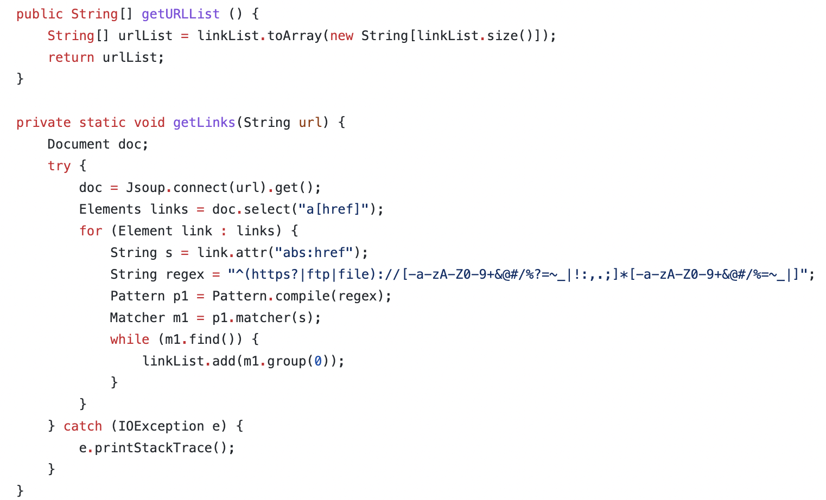
Crawler Author: Jitong Yang

Slide 12
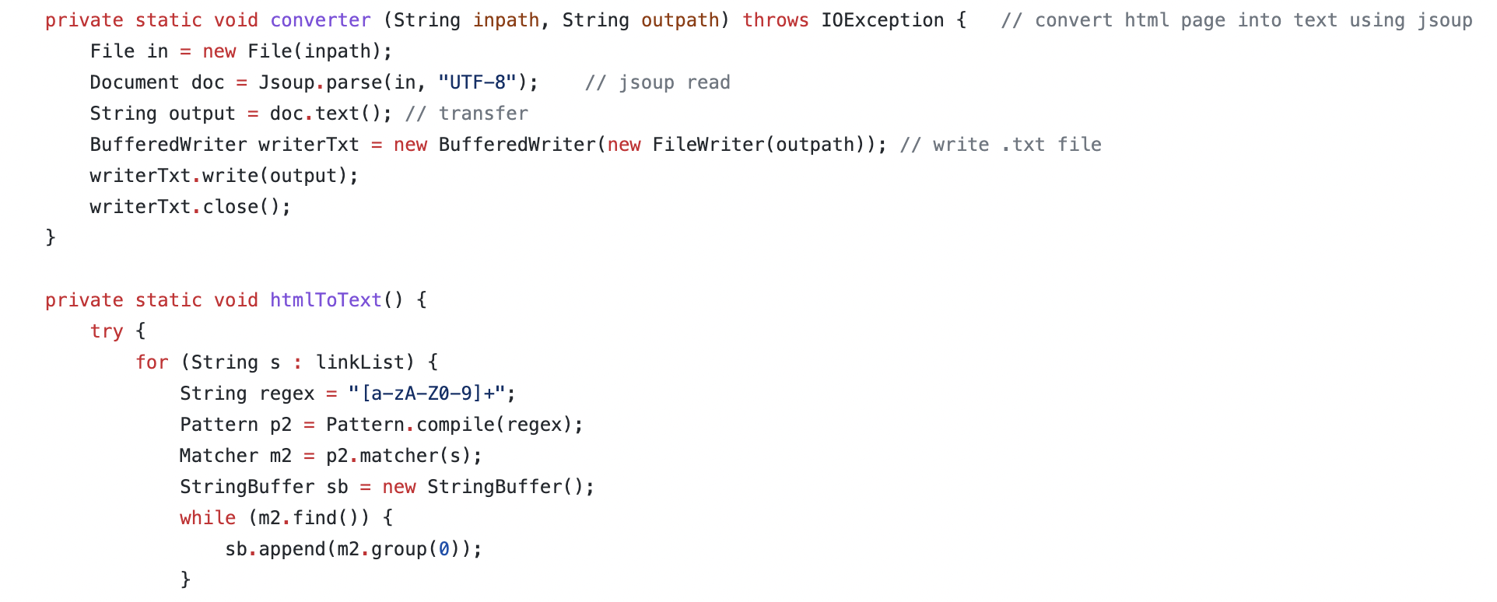
Crawler Author: Jitong Yang

Slide 13
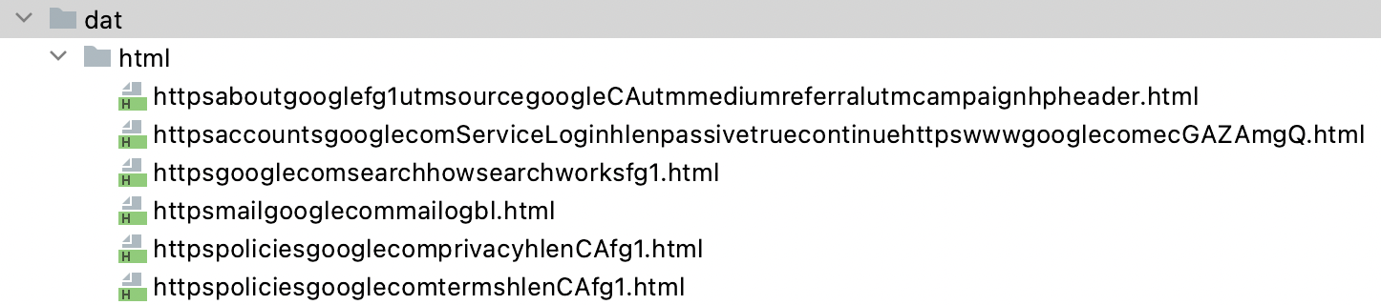
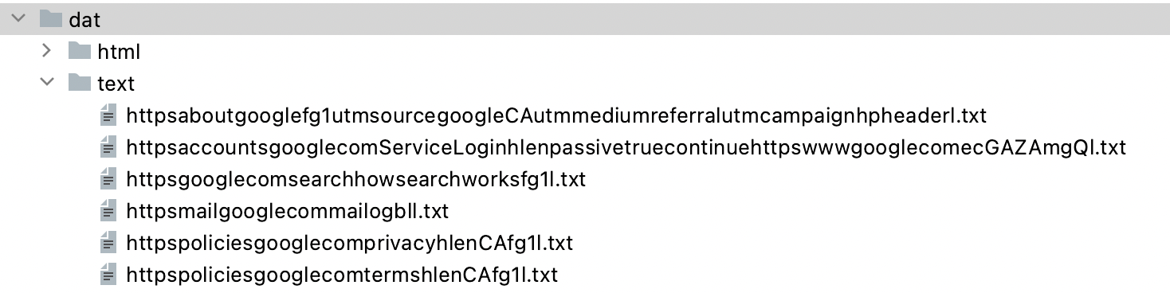
Crawler Author: Jitong Yang

Slide 14
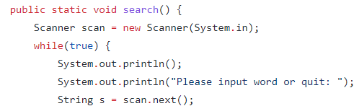
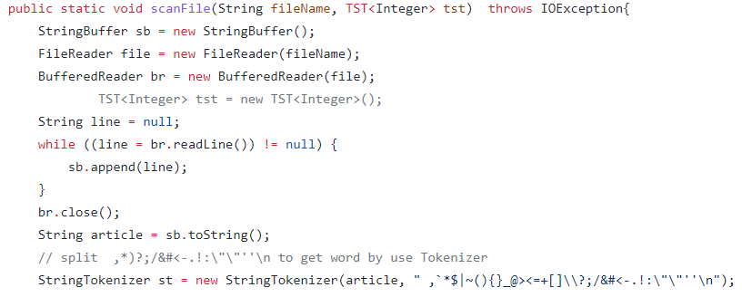
Search Keywords Author: Yuchen Shen
Users can search keywords after searching URLs.
Word segmentation
Unpack the string. Break it down into characters. So we can do a keyword search.

Slide 15
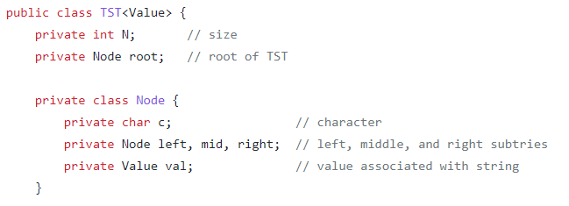
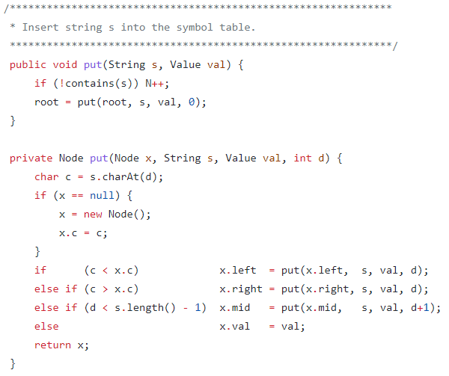
Search Keywords Author: Yuchen Shen
Ternary Search Trie(TST)
Store the keyword and the number of matching keyword
Here we make TST as a class, whose attribute is a character, three nodes and the value associated with string.

Slide 16
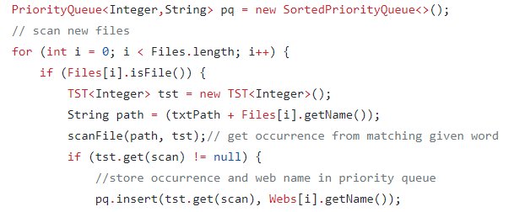
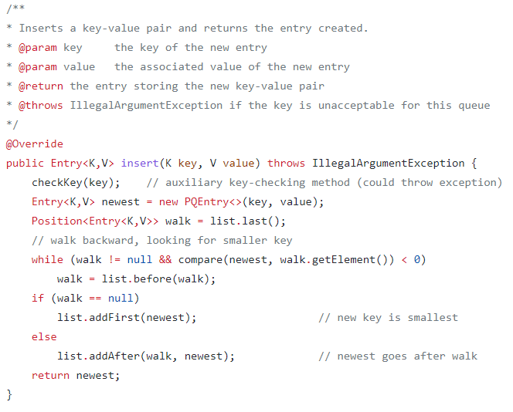
Search Keywords Author: Yuchen Shen
Word Frequency and inverted index
Store the destination URL and how many times the keyword shows in that URL

Slide 17
Spell Checking Author: Yicheng Lu
Comparing the user's input word X with existing word Y from source files.
Correct spelling:
There are at least one word Y in the source file which satisfy Y = X.
Incorrect spelling:
Cannot find Y which satisfies Y = X.
Constructing a vocabulary based on all existing .txt files.
Calculating edit distance between X and all words in Vocabulary by substitution, insertion, and deletion.
Sorting words in vocabulary according to edit distance, and selecting top 10 words.

Slide 18
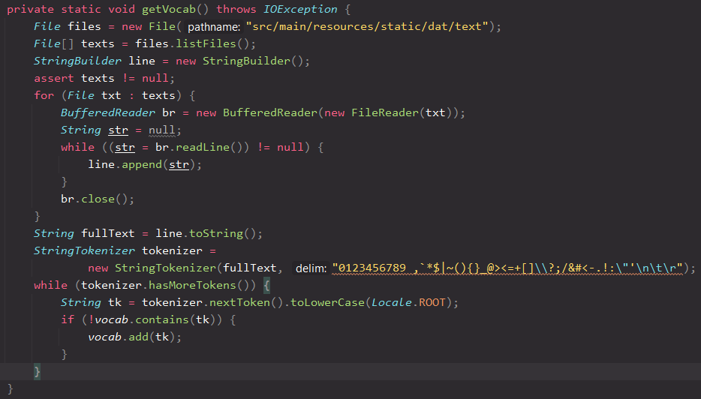
Spell Checking Author: Yicheng Lu
Constructing Vocabulary
Read all text files into a StringBuilder
Tokenize string using StringTokenizer() by all numbers, punctuation and other symbols.

Slide 19
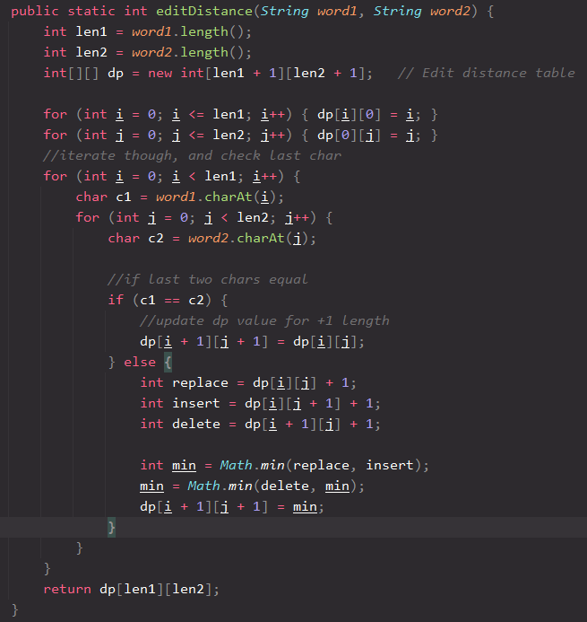
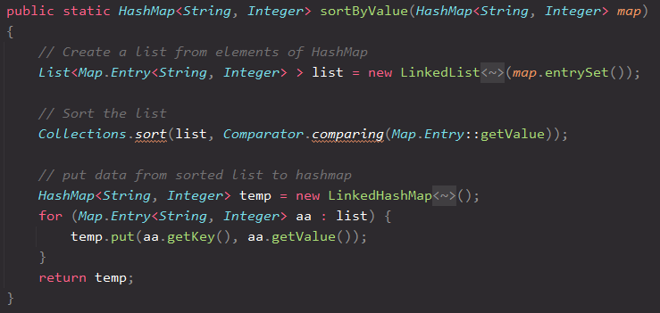
Spell Checking Author: Yicheng Lu

Slide 20
04
Demo

Slide 21
05
Conclusion

Slide 22
Conclusion
In this project, Web Crawl, convert HTML to TXT, TXT document preprocessing, Word frequency, Inverted Index and Spell Checker are used. At the same time, we use hashTable, Queue, TST and other data structures as support.
The search engine, is according to the user needs and a certain algorithm, using a specific strategy to retrieve information from the Internet feedback to the user of a search technology.

Slide 23
THANKS

